Slide 1
Summer School 2024 Graz
Economies of Space. Practices, Discourses and Actors on the Basel Real Estate Market (1400-1700)
Ismail Prada Ziegler

Slide 2
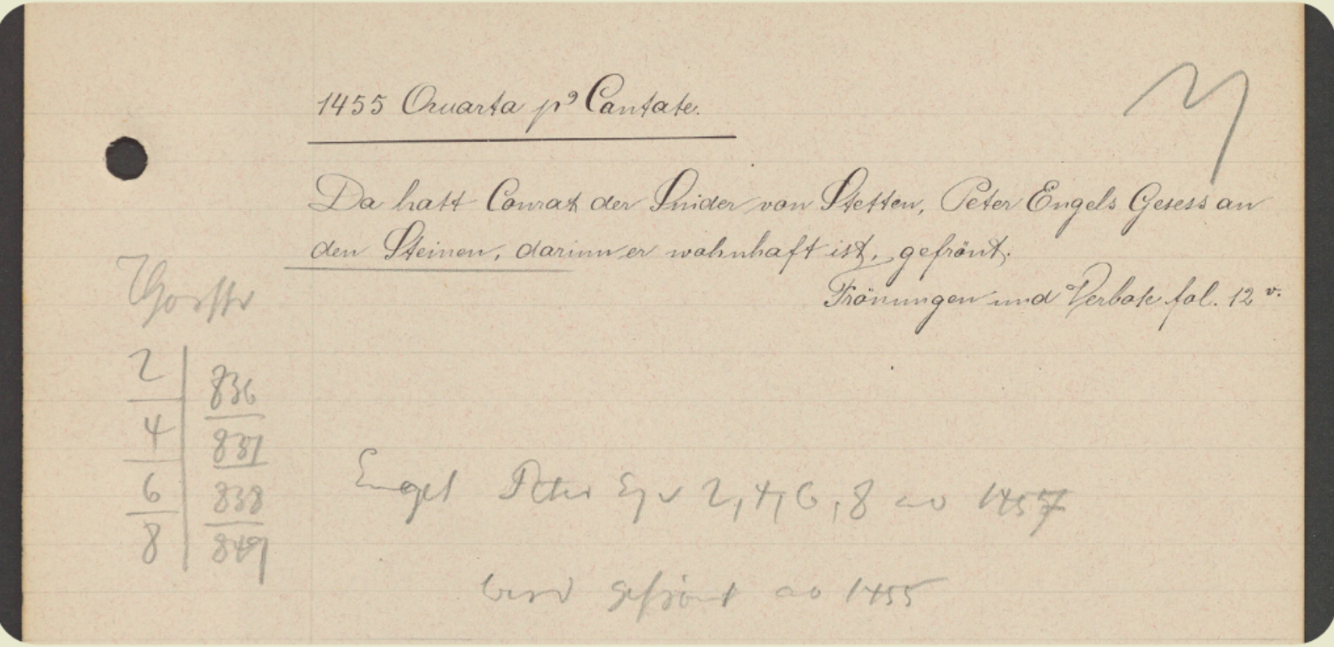
The Historical Land Register of Basel
1400-1700
ca. 80’000 in timeframe
Usually one main event per text:
property purchase
seizures
rent purchase
testament / inheritance
court litigation
rent registries
etc.

Slide 3
A typical document of the HLRB
Enneli Ebin and Lienhart Mornach the butcher as representative of Ulin Mornach, Ulrich Mornachs son and mentioned Ennelis son, sell Symon Sumer the baker and his wife Clara the house which is called Lemlis Hus located at Yengassen between the houses Zum Agstein on one side and the Roten Hus to the other, at the backside touching S. Martinshof, paying interest to the diocese 2 lb & 2 bags of grain to the church S. Martin, otherwise free, for 625 fl.
Notes:
Name example research questions

Slide 4
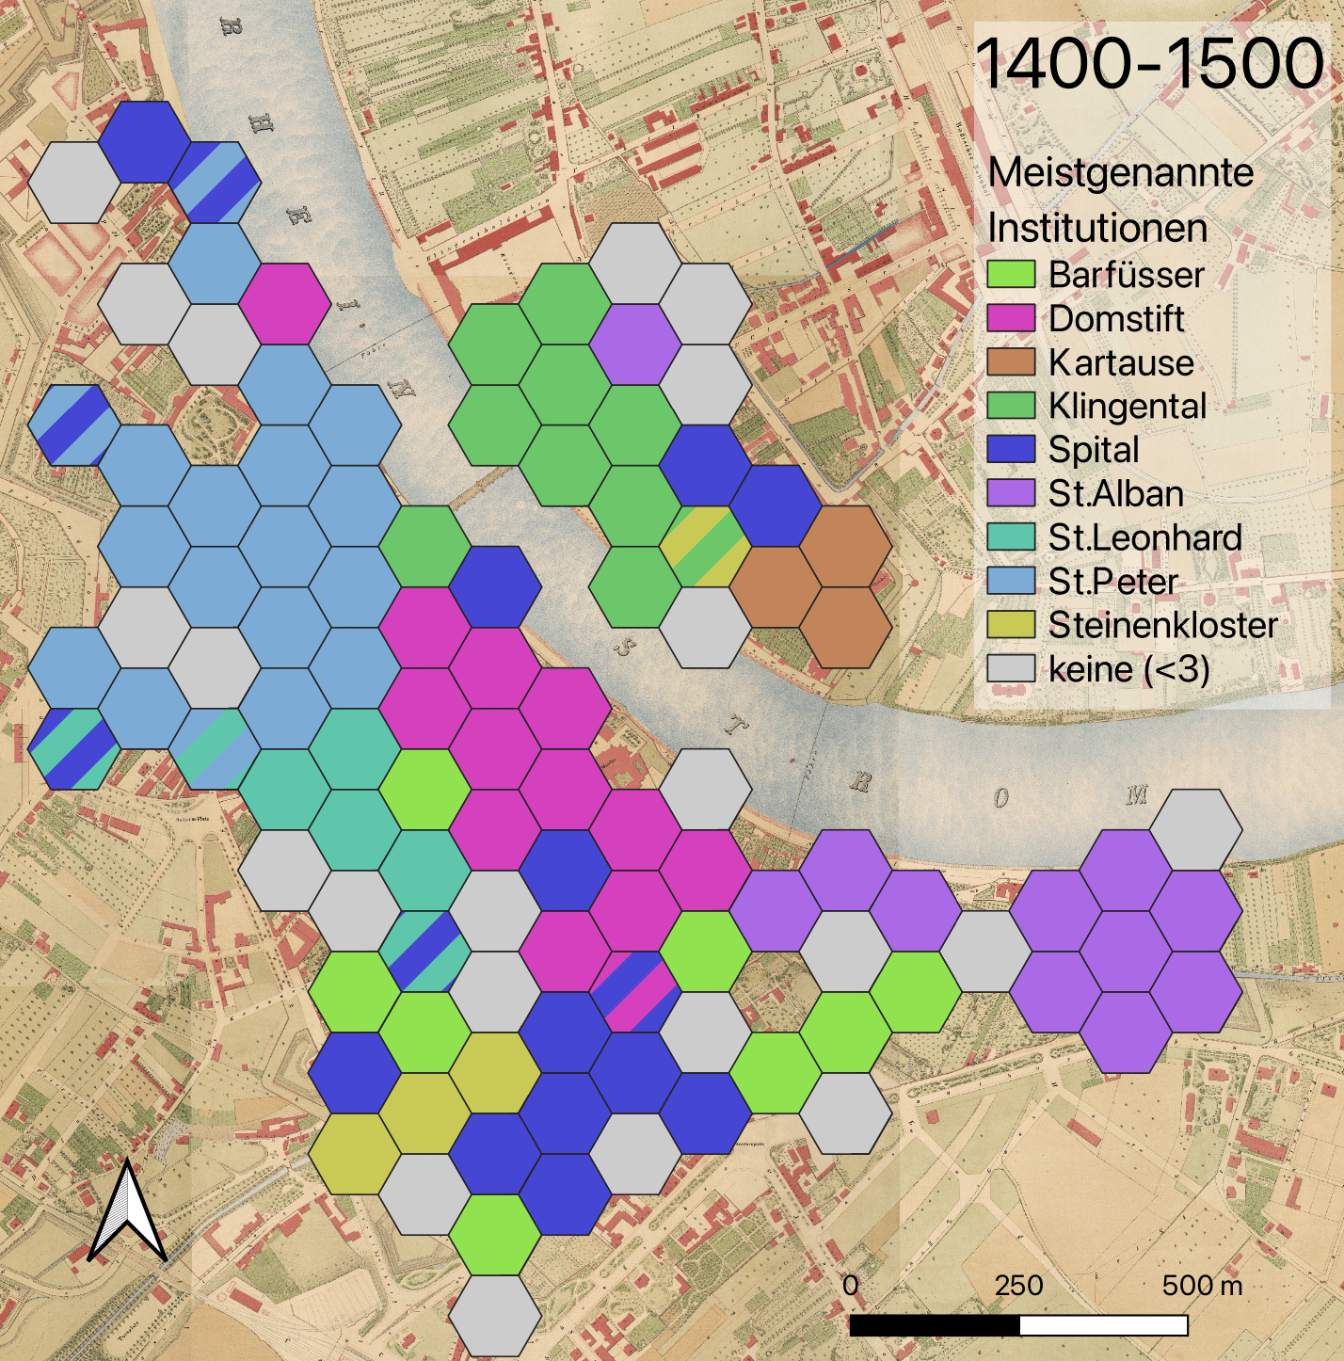
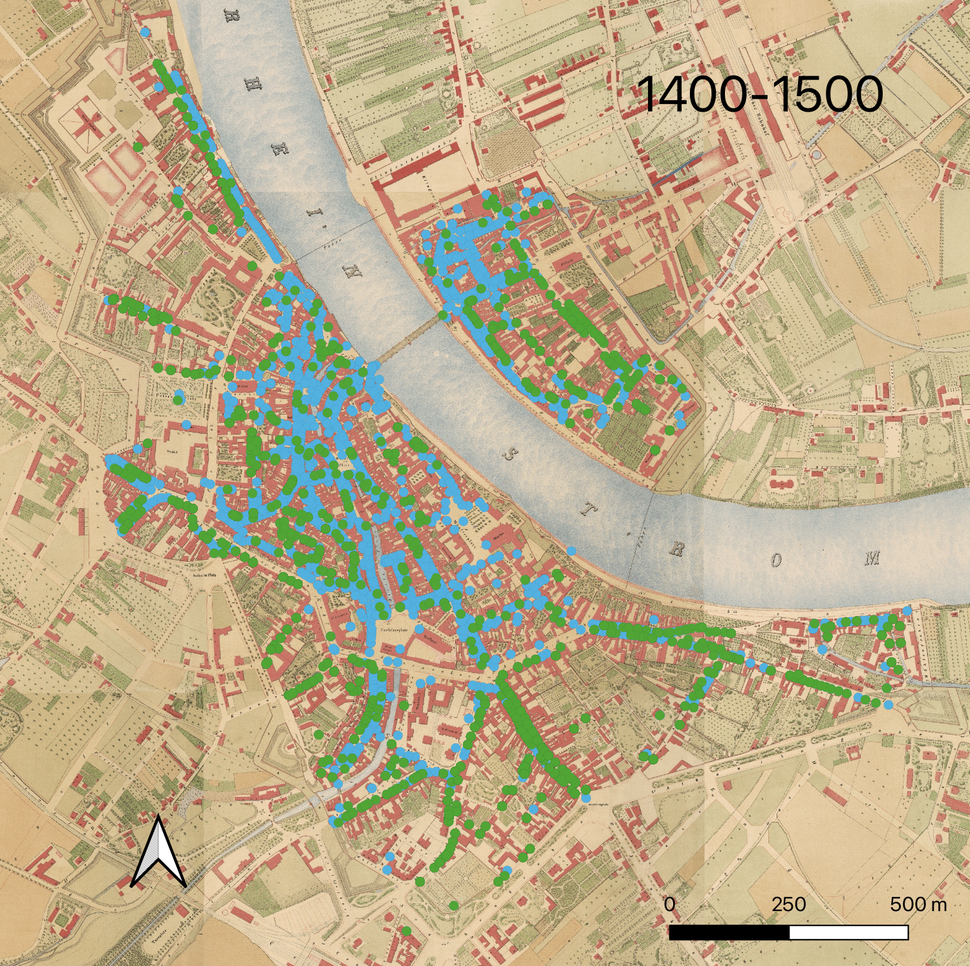
How do we get there?
Notes:
Links genannte Organisationen Rechts Gärten in Dossiers

Slide 5
Event Analysis
Enneli Ebin and Lienhart Mornach the butcher as representative of Ulin Mornach, Ulrich Mornachs son and mentioned Ennelis son, sell Symon Sumer the baker and his wife Clara the house which is called Lemlis Hus located at Yengassen between the houses Zum Agstein on one side and the Roten Hus to the other, at the backside touching S. Martinshof, paying interest to the diocese 2 lb & 2 bags of grain to the church S. Martin, otherwise free, for 625 fl.
Notes:
Only a few different templates necessary!

Slide 6
Common NE-Annotation
Enneli Ebin and Lienhart Mornach the butcher as representative of Ulin Mornach, Ulrich Mornachs son and mentioned Ennelis son, sell Symon Sumer the baker and his wife Clara the house which is called Lemlis Hus located at Yengassen between the houses Zum Agstein on one side and the Roten Hus to the other, at the backside touching S. Martinshof, paying interest to the diocese 2 lb & 2 bags of grain to the church S. Martin, otherwise free, for 625 fl.
Notes:
Which problems do you spot with this?

Slide 7
Long NE-Annotations + Named Entities
Enneli Ebin and Lienhart Mornach the butcher as representative of Ulin Mornach, Ulrich Mornachs son and mentioned Ennelis son, sell Symon Sumer the baker and his wife Clara the house which is called Lemlis Hus located at Yengassen between the houses Zum Agstein on one side and the Roten Hus to the other, at the backside touching S. Martinshof, paying interest to the diocese 2 lb & 2 bags of grain to the church S. Martin, otherwise free, for 625 fl.
Notes:
Much better, but how do we later connect this to a database, how do we normalize this? => nested Tagging

Slide 8
BeNASch - Quick Introduction
Text Layer
Annotate Reference-Mentions and Values.
Description Layer
+Head - required!
+Attributes - entity mention further describing parent
+Descriptors - non-mention further describing parent
Nested: References & Attributes contain Description Layers, Descriptors contain Text Layers.

Slide 9
Layer Examples
Symon Sumer the baker
Description Layer:
Head: Symon Sumer
Attribute: the baker
Description Layer:
Head: baker

Slide 10
Layer Examples
the house located at Yengassen, paying interest to the diocese 2lb
Description Layer:
Head: house
Descriptor: located at Yengassen
Text Layer:
Reference: Yengassen
Description Layer:
Head: Yengassen
Descriptor: paying interest to the diocese 2lb
…Text Layer etc.

Slide 11
Symbiosis with Event/Relation Annotation
his wife Clara
Description Layer:
Head: Clara
Attribute: his wife ← Mention Subclass: Family / Wife
Description Layer:
Head: wife
Reference: his → Coreference to mention of husband
BeNASch is a “close-to-text” annotation

Slide 12
Symbiosis with Event/Relation Annotation
the house located at Yengassen, paying interest to the diocese 2lb
Description Layer:
Head: house
Descriptor: located at Yengassen ← Descriptor Class: located_at
Text Layer:
Reference: Yengassen
Description Layer:
Head: Yengassen
Descriptor: paying interest to the diocese 2lb ← Descriptor Class: dues
…Text Layer etc.
Notes:
dues is an event, not a relation, but we can model all relations event-like, so that doesn’t matter

Slide 13
NE-Classes
4 classes:
Person
Place
Organization
Geo-political Entity
Considered: Miscellaneous
Custom Classes: e.g. Facility for HGB for Buildings
Additional Mention Information
Mention Class, Mention Subclass, Specificity, Ordinality

Slide 14


Workflow
HTR
Manual Annotation
3.6% CER
> 800 documents

Slide 15
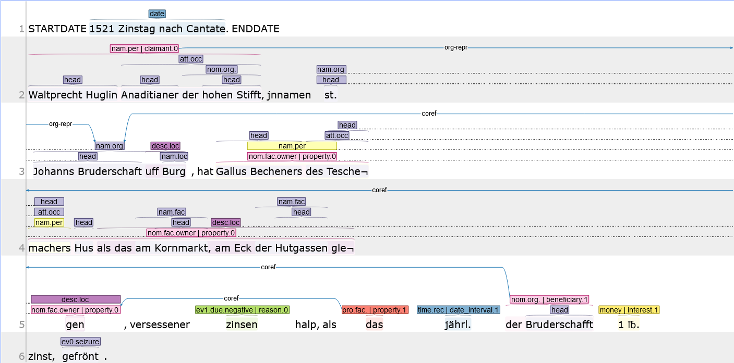
Annotation in INCEpTION

Slide 16
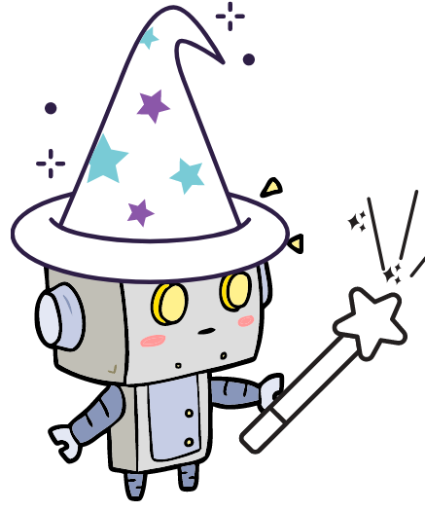

image source

Slide 17
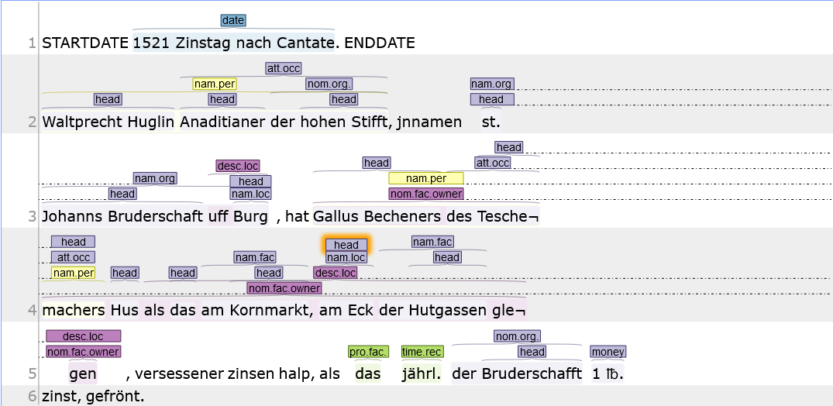
Automated Annotation!

Slide 18
Next Steps
Normalization and Entity Linking
Relation Extraction outside of Nesting
esp. Coreference Resolution
Event Extraction

Slide 19
Summer School 2024 Graz
How to Extract (Named) Entities in Historical Texts?
Ismail Prada Ziegler

Slide 20
In One Image: Sequence Tagging
Unlabelled Data
Labelled Data
Unlabelled Data
Language Model
NER Model
Predicted Data
Base Model
Base Model

Slide 21
Language Models
Mathematical representation of a token / subtoken / character
Germany
France
Berlin
Paris

Slide 22
Language Models
Popular Embeddings:
word2vec (word-level)
fasttext (word-level + subword-information)
Contextualized Embeddings:
contextual character-emb (Flair) (character-level)
Transformers (BERT) (WordPiece-level)
Trained by learning to predict likely words correctly from context (strongly simplified)

Slide 23
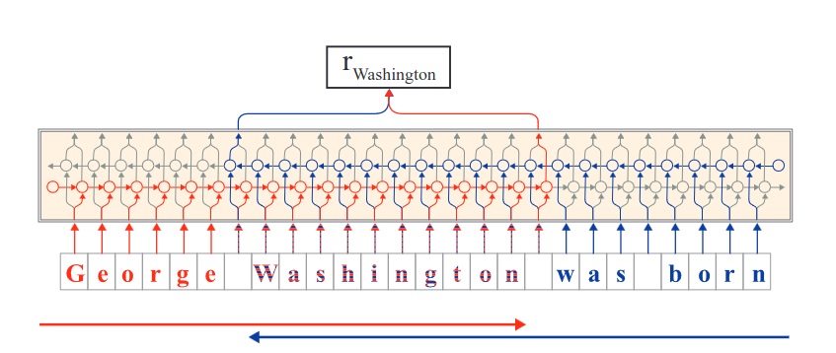
Contextual Character Embeddings

Slide 24
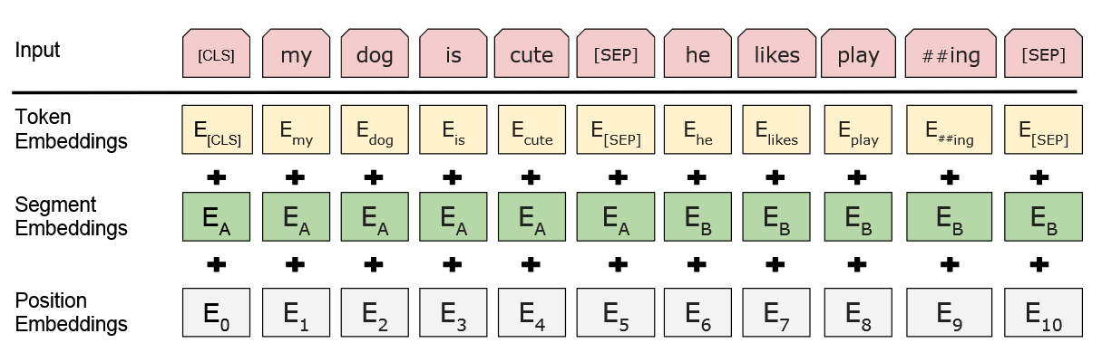
BERT (Transformer)
Notes:
Explain BytePair/WordPiece Encoding
Disadvantage, needs huge amounts of data, even for finetuning
https://arxiv.org/pdf/1810.04805

Slide 25
Labelled Data Format
Symon | B-PER
Sumer | I-PER
the | I-PER
baker | E-PER
lives | O
at | O
the | O
Yengassen | S-LOC
Typical Format: BIO(ES)

Slide 26
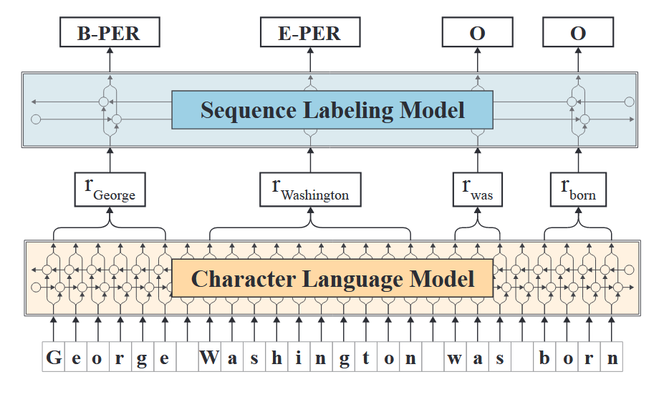
Flair Sequence Tagging Architecture
Notes:
Sequence Labeling Model is per default a bidirectional LSTM model + CRF output layer

Slide 27
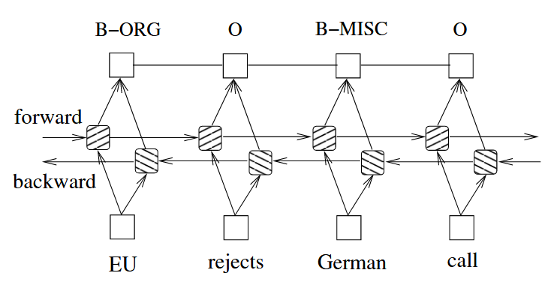
Bi-LSTM + CRF (Huang et al. 2015)
Notes:
https://arxiv.org/pdf/1508.01991

Slide 28
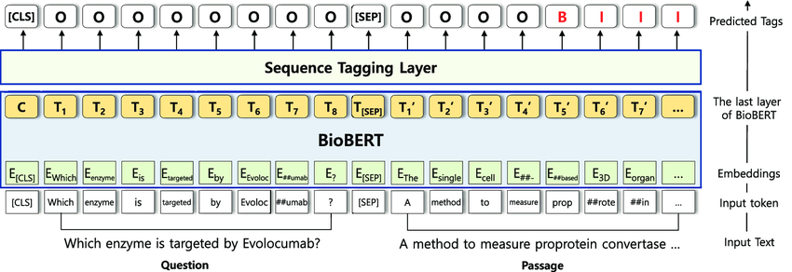
Transformer Sequence Tagging Arch.
Notes:
The sequence tagging layer can be as little as simply a crf layer and nothing more. the task-specific training is usually done as a finetuning.
https://www.researchgate.net/publication/361400671_Sequence_Tagging_For_Biomedical_Extractive_Question_Answering

Slide 29
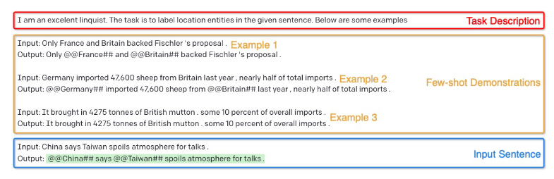
Generative AI (LLMs)
Source: Wang et al. 2023
Notes:
Much worse results when compared to fully supervised systems, but good results when low resource scenario
https://arxiv.org/pdf/2304.10428

Slide 30
Main Training Strategies
Training from scratch
Own training data needed
Finetuning
Own training data needed
Harness the power of a pre-trained model
Few-Shot Learning
Only show a few examples to “explain” the task to the model
Harness the power of a pre-trained model

Slide 31
Evaluation Metrics
Ground Truth | Prediction | Counts as
PER | PER | True Positive
O | O | True Negative
PER | O | False Negative
O | PER | False Positive
Recall → TP / (TP + FN)
Precision → TP / (TP + FP)
F-Score → 2 * ((Recall * Precision) / (Recall + Precision))

Slide 32
Challenges with Historical Data
Let’s collect some together!
Great summary can be found in Ehrmann et al. 2023: “Named Entity Recognition and Classification in Historical Documents: A Survey”

Slide 33
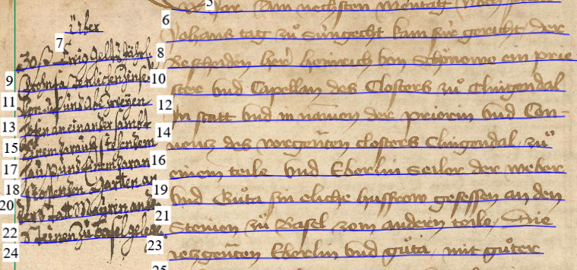
Challenges: Noisy Input
Errors in OCR/HTR
measured in Character Error Rate or Word Error Rate
Errors in the Layout Analysis

Slide 34
Challenges: Dynamics of Language
Historical Spelling Variation
Conratz, Cunratz, Cunraden, Cunraten, Conraten, Chunrad, Cunrad, Cunrads, Conrad, Conradt, Cunrat, Conrat, Cuntz, Contz
Naming Conventions
Entity and Context Drift

Slide 35
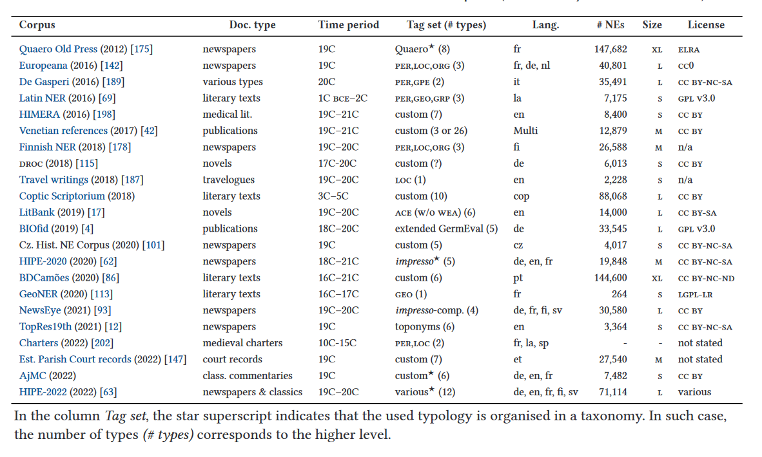
Challenges: Lack of Resources
Source: Ehrmann et al. 2023

Slide 36
Challenges: Lack of Resources
Source: Ehrmann et al. 2023
Notes:
Almost no medieval / early modern corpora
Add to that, often no standard on how to annotate!
BUT: often smaller corpora like editions are not named in these lists. E.g. in Switzerland the SSRQ-corpus

Slide 37
Solutions: Noise
Character-level emb. can handle noisy input and spelling variation
Spelling normalization and OCR Post-correction are usually not necessary anymore
WordPiece struggles here
CharBERT introduces character-level features into BERT

Slide 38
Solutions: Low Resource
Finetuning / Few-shot-technique don’t need as
GenAI has shown to outperform Transformer systems in low resource scenarios (Wang et al. 2023)
Enough data for Transformer hard to come by
(enough for Latin though → Latin BERT)
When using other (historical) datasets/models → Domain shift problem!

Slide 39
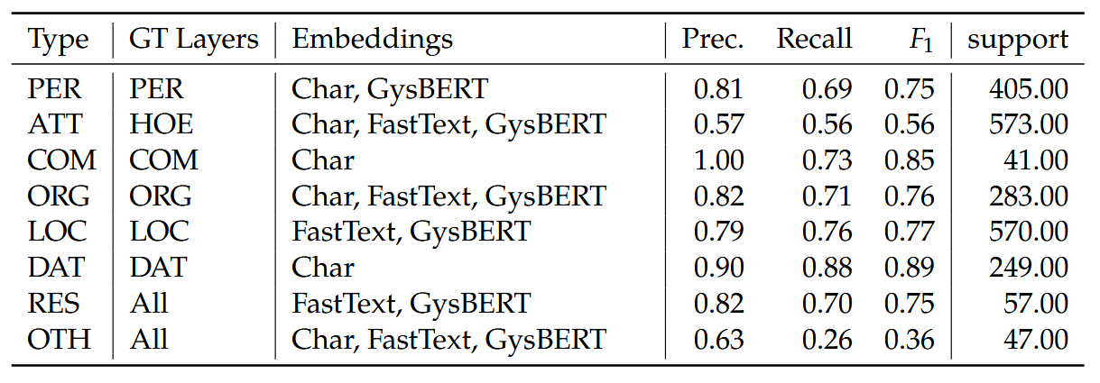
Example Experiments (16th-18th c. dutch)
Source: Koolen et al. 2024
Notes:
https://2024.dhbenelux.org/wp-content/uploads/2024/05/DHB24_paper_Koolen_et-al_accessing-republic.pdf
Bi-LSTM architecture as sequence tagger (flair)
why not transformers -> finetuning those would need much more data

Slide 40
Now let’s get our own hands on it!

Slide 41
Image Sources
Alan Akbik, Duncan Blythe, and Roland Vollgraf. 2018. Contextual String Embeddings for Sequence Labeling. In Proceedings of the 27th International Conference on Computational Linguistics, pages 1638–1649, Santa Fe, New Mexico, USA. Association for Computational Linguistics.
Jacob Devlin, Ming-Wei Chang, Kenton Lee, and Kristina Toutanova. 2019. BERT: Pre-training of Deep Bidirectional Transformers for Language Understanding. In Proceedings of the 2019 Conference of the North American Chapter of the Association for Computational Linguistics: Human Language Technologies, Volume 1 (Long and Short Papers), pages 4171–4186, Minneapolis, Minnesota. Association for Computational Linguistics.
Huang, Z., Xu, W., & Yu, K. (2015). Bidirectional LSTM-CRF models for sequence tagging. arXiv preprint arXiv:1508.01991.
Yoon, Wonjin & Jackson, Richard & Lagerberg, Aron & Kang, Jaewoo. (2022). Sequence Tagging For Biomedical Extractive Question Answering. Bioinformatics. 38. 10.1093/bioinformatics/btac397.
Wang, Shuhe & Sun, Xiaofei & Li, Xiaoya & Ouyang, Rongbin & Wu, Fei & Zhang, Tianwei & Li, Jiwei & Wang, Guoyin. (2023). GPT-NER: Named Entity Recognition via Large Language Models.
Ehrmann, M., Hamdi, A., Pontes, E. L., Romanello, M., & Doucet, A. (2023). Named Entity Recognition and Classification in Historical Documents: A Survey. ACM Computing Surveys, 56(2), 27:1-27:47. https://doi.org/10.1145/3604931
Koolen, M., Renkema, E., Groskamp, N., Smit, F., Reinders, J., Sluijter, R., ... & Oddens, J. Accessing the Republic. Entity extraction from the resolutions of the Dutch States-General.

